Slide 1
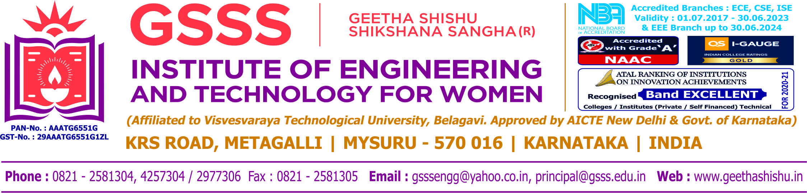

INTERNSHIP PRESENTATION
ON
“CHAMUNDESHWARI ELECTRICAL SUPLLY CORPORATION”
BY
RAKSHITHA G
4GW19EE030
Under the Guidance of
Internal Guide External Guide Smt. SMITHA S K Sri. LOKESH L
Assistant Professor Assistant Exeutive Engineering
Dept. of EEE, GSSSIETW CESC, Mysore
Department of Electrical & Electronics Engineering

Slide 2
CONTENTS
COMPANY PROFILE
INTRODUCTION
OBJECTIVES
EQUIPMENTS USED
ENERGY METER
TRANSFORMERS
DEPARTMENTS IN CESC
CONCLUSION

Slide 3

COMPANY PROFILE
The CESC company provides electricity to five districts of Karnataka
Districts under the jurisdiction of CESC are :
Mysore
Chamarajanagar
Mandya
Kodagu
Hassan

Slide 4
INTRODUCTION
CESC Limited is a socially responsible company, which aims at contributing towards the up liftment of the poor and underprivileged residing in its area of operation, along with its focus on generating profits, protecting the interests of investors and shareholders, and serving the customers with utmost satisfaction.

Slide 5
OBJECTIVES
To understand the importance of electric energy and utilizing it in the efficient way by using latest technologies.
To gain desired skill set, better knowledge and opportunities for the better future.

Slide 6
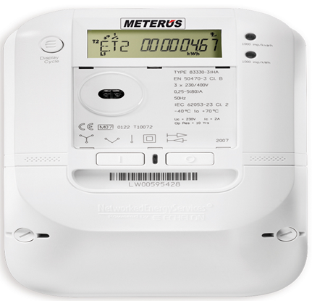
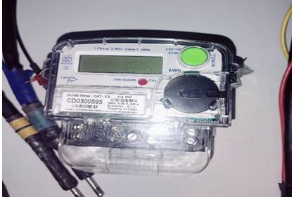
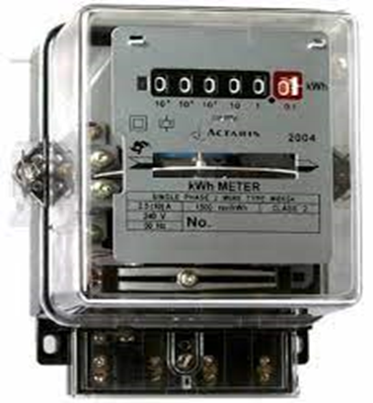
METERS
Smart meter Electromechanical meter
Electronic meter

Slide 7
Smart meter:
It provides detailed information on consumption in order to reduce electricity bills.
It increases the knowledge about the status of the electricity bill.
Incorporates a power limiting circuit breaker
Its disadvantage is that it exposes power grid to cyber attacks.
Electricity meter:
The most common type of electricity meter is the electromechanical watt-hour meter.
It consists of rotating Aluminium disc mounted on a spindle between two electro magnets.
One of the disadvantage is there is no chance of future advancement.
Electronic meter:
Its metering is highly accurate.
It measures current both in neutral and phase lines.
There are no moving parts so its also known as “Static Energy Meter”.

Slide 8
ENERGY METER TESTING LABORATORY
An energy meter is an instrument used to measure electrical energy.
It keeps record of the total energy consumed in a circuit during a particular period.
Devices and equipment that can test multiple energy-meters at the same time were shown in the laboratory.
Different sections were allocated for LT meter testing and HT meter testing.
Energy meter calibration is a process required to determine and reduce the error when the energy is measured.
The errors in the energy meter can be caused by different sources like voltage transformers, current transformers errors due to phase angle, crystal oscillators, etc.
The performance tests of an energy meter as per its calibrated values are checked under various tests for different aspects like its mechanical aspects, electrical circuiting and climatic conditions.

Slide 9
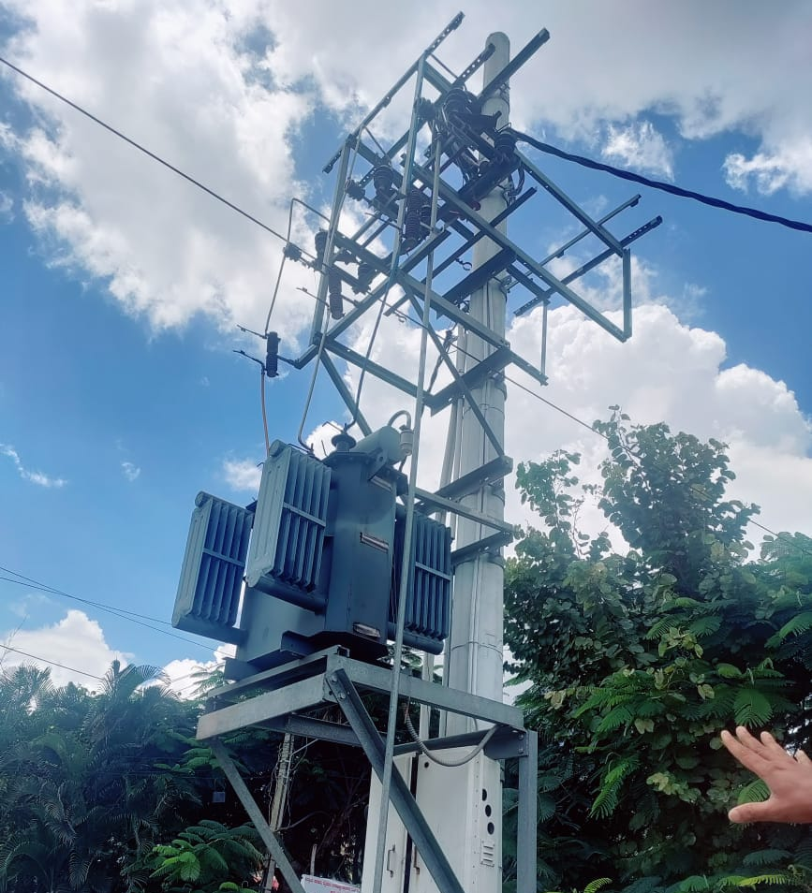
TRANSFORMERS
A transformer is an inductive electrical device
for changing the voltage of alternating
current.
TYPES OFBTRANSFORMERS
Power transformer
Distribution transformer
Instrument transformers
Auto-transformer
Resonant transformer

Slide 10
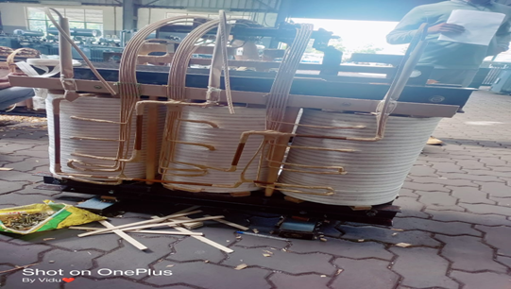
CONSTRUCTION
CORE
WINDING
TANK
TAPPING
CORE AND COIL ASSEMBLY

Slide 11
TYPES OF TESTING
Measurement of voltage ratio test.
Measurement of no load loss test(Open circuit test).
Measurement of load loss and impedance voltage test(Short circuit test).
BDV Oil test.

Slide 12

DEPARTMENTS IN CESC
1.CUSTOMERCARE CENTRE
A centralized Customer care centre has been established under RAPDRP CESC deploys CSRs (Customer Service Representatives)

Slide 13
DEPARTMENTS IN CESC
2.BUDGET ALLOCATION
CESC has been an early adopter of Corporate Social Responsibility (‘CSR’) initiatives.
A company should spend a minimum of 2% of the average net profits made during the 3 (three) immediately preceding financial years.
CESC’s CSR activities will focus on activities like health, education, environment, national heritage.

Slide 14


CYBER SECURITY
Cyber security focuses on protecting computer systems from unauthorized access.
India stands 10th in the cyber crime in world.
Types of cyber crime include hacking, phishing, spam email, Malware, ATM skimming.

Slide 15
Safety tips against cybercrime
Use Antivirus software.
Insert Firewalls
Uninstall unnecessary software.
Maintain backup.
Check security settings.
Never give your name or address to strangers.
Learn more about the internet privacy.

Slide 16
CONCLUTION
During this internship training period , I had learnt about the modern technologies that are emerging .
Therefore I conclude that the industrial training program at CESCOM has provided many benefits to me.

Slide 17


